Slide 1
Promotions II
Lecture 10

Slide 2
Final Test
Some updates
Final test will be using Examplify
Need 2nd device for ZOOM proctoring
Watch out on LumiNUS email/announcements for further updates

Slide 3
Learning Objectives
Understand the various promotional tools and what each can do for a marketer

Slide 4
ORGANIZATION
1. Advertising
2. Personal Selling
3. Sales Promotion
4. Public Relations
5. Direct Marketing

Slide 5
ADVERTISING
Major Decisions
Set Objectives
Sales (aim is to increase sales)
Communications (aim is to either inform/educate, persuade and/or remind)
Budget
Message
Media
Campaign Evaluation vs Objectives

Slide 6
ADVERTISING - cont’d
Message Decisions
Message Generation
Communicate to consumers, dealers, experts and competitors
Imagine how consumers use products
Find out benefits sought in product
Involve consumers in idea/execution process
Create multiple possibilities for screening

Slide 7
ADVERTISING - cont’d
Message Evaluation & Selection
Appeals must be MEANINGFUL
Benefits pointed to consumers
Products made desirable & interesting
Appeals must be DISTINCTIVE
Show product is better than alternatives
Catch attention by being different from competitors
Appeals must be BELIEVABLE
Truthful & not deceptive/misleading claims
Notes:
Examples: https://visme.co/blog/types-of-advertising-appeals/

Slide 8
ADVERTISING - cont’d
Message Execution
Style
Slice-of-life
Lifestyle
Fantasy
Mood/Image
Testimonial
Musical
Personality Symbol (Heroes)
Scientific Expertise
Endorsement
Notes:
The message can be presented in the following execution styles.
Slice of life shows one or more “typical” people using the product in a normal setting. For example, a Silk Soymilk “Rise and Shine” ad shows a young professional starting the day with a healthier breakfast and high hopes.
Lifestyle shows how a product fits in with a particular lifestyle.
Fantasy creates a fantasy around the product or its use.
Mood or image builds a mood or image around the product or service, such as beauty, love, intrigue, serenity, or pride. Few claims are made about the product or service except through suggestion. For example, ads for Singapore Airlines feature soft lighting and refined flight attendants pampering relaxed and happy customers.
Musical shows people or cartoon characters singing about the product. For example, one of the most famous ads in history was a Coca- Cola ad built around the song “I’d Like to Teach the World to Sing.”
Personality symbol creates a character that represents the product. The character might be animated (the jolly Green Giant, McDull the Pig [Hong Kong], Garfield the Cat) or real (the Marlboro man, Aaron Kwok—a Hong Kong celebrity in the Pepsi Coke ads).
Technical expertise shows the company’s expertise in making the product. Thus, BBK (Bu Bu Gao, a top Chinese appliance manufacturer that makes DVD players) used Arnold Schwarzenegger in its ads to promote BBK’s expertise as “Truth without Lies” (a concept borrowed from Schwarzenegger’s movie True Lies).
Scientific evidence presents survey or scientific evidence that the brand is better or better liked than one or more other brands. For years, Crest toothpaste has used scientific evidence to convince buyers that Crest is better than other brands at fighting cavities.
Testimonial evidence or endorsement features a highly believable or likable source endorsing the product. It could be ordinary people saying how much they like a given product.

Slide 9
Slice of Life

Slide 10

Fantasy
Cartier Odyssey (3:30 mins)
The panther is Cartier’s signature animal symbol
Ad targets at high end customers from Europe, China, India and Russia
Evokes old-world luxury charm but is designed for the modern lady/man with status and wealth
We see the panther returning to its Parisian lady owner at the end
This is an example of visual storytelling using fantasy as the message execution style

Slide 11
Mood
Notes:
The SIA ad, “All around the world, you are a great way to fly”, creates a mood of quality service, comfort and warmth. Even the colour tones are warm tones (yellows and muted feels)
The BMW ad and visual creates a mood of speed and thrill. The shoes, with an imprint on the soles of the right shoe suggests that the driver is often pressing on the accelerator, suggesting that he enjoys speeding

Slide 12


Musical my personal faves
Volkswagen : Star Wars |2011 (1min)
Volkswagen : The Bark Side | 2012 (1 min)
Notes:
These Volkswagen commercials were shown during the US Super Bowl Games in 2011 and 2012.
The 2011 version was highly popular and a firm favourite with the audience. It’s emotional and humour appeal resonated with viewers. Following the positive brand image and effectiveness of the 2011 commercial, Volkswagen followed up with the Bark Side with the 2012 commercial. For non-Star Wars fans, there is a word play and pun on “the bark side” as Darth Vader and the Emperor were always known to be the “Dark Side” .

Slide 13
Personality
Notes:
Marlboro – to promote and advertise Marlboro, a cigarette company, the ad agency came up with the “Marlboro Man” who is often personified as the American cowboy; one that is rugged, strong and hardworking.
Rosie the Riveter, is a cultural pop icon that started in World War II. At that time, with the men out at the battlefields, women had to assume roles by working in jobs that used to be dominated by men (cars, manufacturing, electronics). Rosie the Riveter became to be seen as a symbol of women empowerment, seeking women’s economic advantage and gender equality.
Superman – someone who can do everything and solve all problems. Except kryptonite.

Slide 14
Testimonial

Slide 15

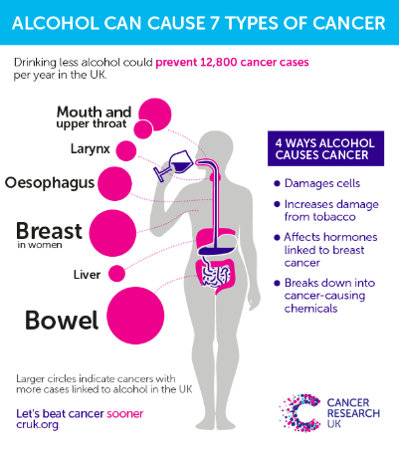
Scientific Expertise

Slide 16
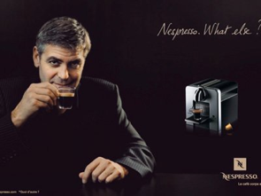
Endorsement / Lifestyle / Personality Symbol

Slide 17
ADVERTISING - cont’d
Tone
Positive/Negative
Serious/Humorous
Factual/Argumentative
Words
Creative phrasing (headline, etc.)
Format
Size
Colour
Illustration
Placement

Slide 18
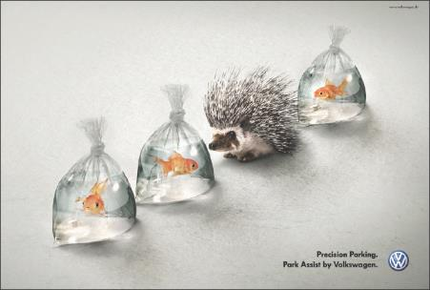
Developing Advertising Strategy
Message Execution
Message execution also includes:
Tone
Positive or negative
Serious/humorous
Attention-getting words
Creative phrasing, headlines
Format
Illustration
Headline
Copy
Placement
Notes:
Novel formats can help an advertisement stand out. In this Volkswagen ad, the illustration does most of the work in illustrating the car maker’s parking assist feature.
The advertiser must choose a tone for the ad. For example, P&G always uses a positive tone: Its ads say something very positive about its products. Other advertisers now use edgy humor to break through the commercial clutter. Bud Light commercials are famous for this.
The advertiser must use memorable and attention-getting words in the ad. For example, rather than claiming simply that its laundry detergent is “superconcentrated,” Method asks customers, “Are you jug addicted?” The solution: “Our patent-pending formula that’s so fricken’ concentrated, 50 loads fits in a teeny bottle. . . . With our help, you can get off the jugs and get clean.”
Finally, format elements make a difference in an ad’s impact as well as in its cost. A small change in an ad’s design can make a big difference in its effect. In a print ad, the illustration is the first thing the reader notices—it must be strong enough to draw attention. Next, the headline must effectively entice the right people to read the copy. Finally, the copy—the main block of text in the ad—must be simple but strong and convincing. Moreover, these three elements must effectively work together to persuasively present customer value.

Slide 19
ADVERTISING - cont’d
Consumer Generated Content
Message ideas, videos, and other brand content from consumers
Incorporate into brand messages
Greater customer engagement

Slide 20
Developing Advertising Strategy
Selecting Advertising Media
The major steps in advertising media selection are:
Determining reach, frequency, impact, and engagement
Choosing among major media types
Selecting specific media vehicles
Choosing media timing

Slide 21
Developing Advertising Strategy
Determining Reach, Frequency, Impact, and Engagement
Reach is a measure of the percentage of people in the target market who are exposed to the ad campaign during a given period of time. Example: 70% for a month.
Frequency is a measure of how many times the average person in the target market is exposed to the message. Example: 7 times a month
Impact is the qualitative value of a message exposure through a given medium.
Engagement is a measure of things such as ratings, readership, listenership, and click-through rates.

Slide 22
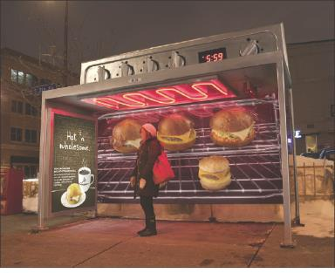
Developing Advertising Strategy
Choosing among Major Media Types
Selecting media vehicles involves decisions presenting the message effectively and efficiently to the target customer and must consider the message’s:
Impact
Effectiveness
Cost

Slide 23
ADVERTISING - cont’d
Media Vehicle Selection
Newspapers
TV
Radio
Magazines
Internet & Mobile Phones
Outdoor

Slide 24
ADVERTISING - cont’d
Media Scheduling
Timing of ads
Three Options:
Continuity
Scheduling exposures evenly within given period
Used when buyers must be reached on continuous basis (e.g., high repeat-purchase goods)

Slide 25
ADVERTISING - cont’d
Pulsing
Scheduling exposures unevenly over given period
Used when demand is continuous but fluctuating
Flighting
Concentrating exposures for heavy short-run impact
Used when budget is limited & demand seasonal

Slide 26
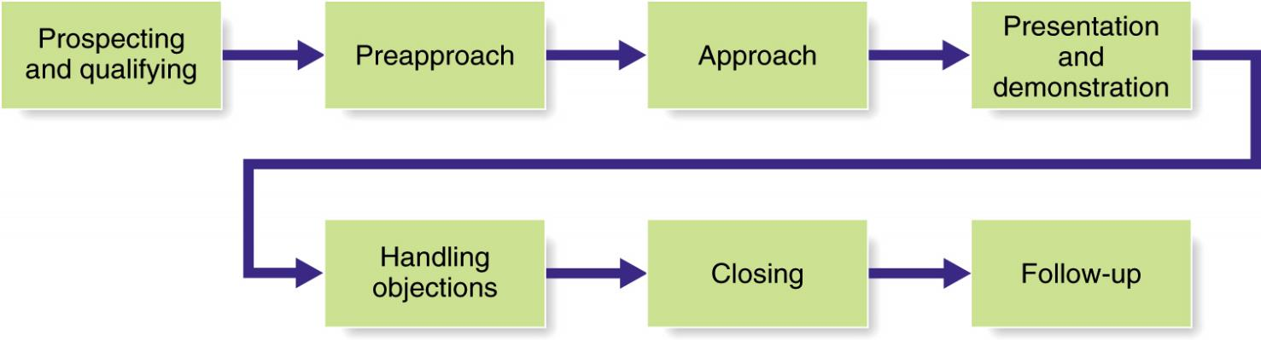
PERSONAL SELLING
Major Steps in Effective Selling

Slide 27
SALES PROMOTION
Three Targets:
CONSUMER: Samples, rebates, coupons, price-offs, contests, etc
TRADE: Discounts, allowances, trade shows, etc
SALES FORCE: Bonuses, contests, rallies, etc

Slide 28
SALES PROMOTION - cont’d
Advantages:
Faster sales vs advertising in short-run
Encourage trial & temporary brand switching
Get consumers to “load up” on brand
Add excitement & pulling power if used with ads
Obtain trade & sales force support
Disadvantages:
Too much price promotion connotes cheap brand
Leads consumer to buy only if brand is on sale
Does not build long-term preference & loyalty

Slide 29
PUBLICITY & PUBLIC RELATIONS
Various Tools:
News
Speeches
Special Events
Written Materials
Audio-Visual Materials
Corporate Identity Materials
Public Service Activities

Slide 30
PUBLICITY & PUBLIC RELATIONS - cont’d
Advantages:
Raise corporate image
Rebuild interest in declining products
Increase public awareness at lower cost vs advertising
Overcome perceptual defences of consumers
Disadvantages:
Can be positive or negative
Less controllable vs. other promotional tools

Slide 31
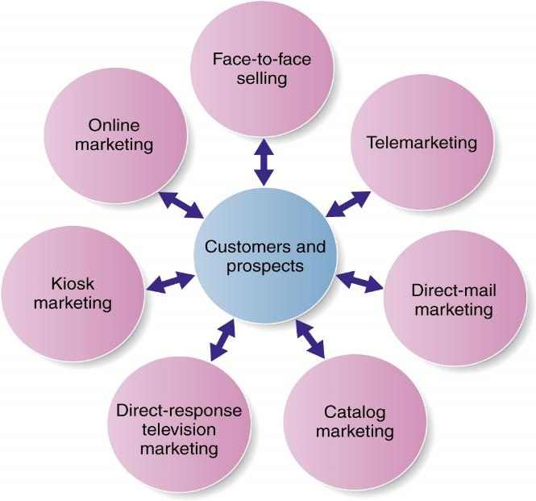
DIRECT MARKETING
Direct marketing consists of direct connections with carefully targeted individual consumers to both obtain an immediate response and cultivate lasting customer relationships
Forms of Direct Marketing

Slide 32
DIRECT MARKETING - cont’d
Reasons for Growth:
To consumers
Convenience
Access to many products
Access to comparative info
Interactive & immediate
To marketers
Precision
Efficiency
Media cost reduction
Alternative distribution channel
Minimal inventory

Slide 33
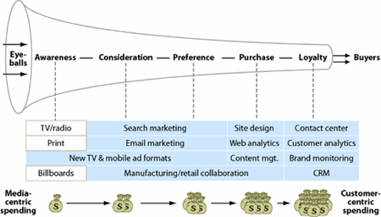
Offline-Online Tools

Slide 34

DIGITAL & SOCIAL MEDIA MARKETING
Mobile Marketing
Online Marketing
Online advertising
Email marketing
Viral marketing
Online video
Blogs
Social media
Spam

Slide 35
Social Media Marketing
Advantages:
Targeted and personal
Interactive
Immediate and timely
Real-time marketing
Cost effective
Engagement and social sharing capabilities
Notes:
Social Media Marketing
There exists a dazzling array of online social media and digital communities. Countless independent and commercial social networks have arisen that give consumers online places to congregate, socialize, and exchange views and information. Wherever consumers congregate, marketers will surely follow.
Using Social Media
Marketers can use existing social media or they can set up their own. Using existing social media seems the easiest. Thus, most brands have set up shop on a host of social media sites with links to each brand’s Facebook, Google+, Twitter, YouTube, Flickr, Instagram, or other social media pages.
Social Media Marketing Advantages and Challenges
Because consumers have so much control over social media content, even the seemingly most harmless social media campaign can backfire.
million.” With social media, “you’re going into the consumer’s backyard. This is their place,” warns one social marketer. “Social media is a pressure cooker,” says another. “The hundreds of thousands, or millions, of people out there are going to take your idea, and they’re going to try to shred it or tear apart and find what’s weak or stupid in it.”
Integrated Social Media Marketing
Most large companies are now designing full-scale social media efforts that blend with and support other elements of a brand’s marketing strategy and tactics. Using social media successfully involves integrating a broad range of diverse media to create brand-related social sharing, engagement, and customer community.

Slide 36
Public Policy Issues in Direct and Digital Marketing
Irritation, Unfairness, Deception, and Fraud
Irritation – Annoying and offending customers
Unfairness – Taking unfair advantage of impulsive or less-sophisticated buyers
Deception – Mailers and bodycopy designed to mislead consumers
Fraud – Identity theft and financial scams
Consumer Privacy
Concern that marketers may know too much about consumers and use this information to take unfair advantage

